Slide 1
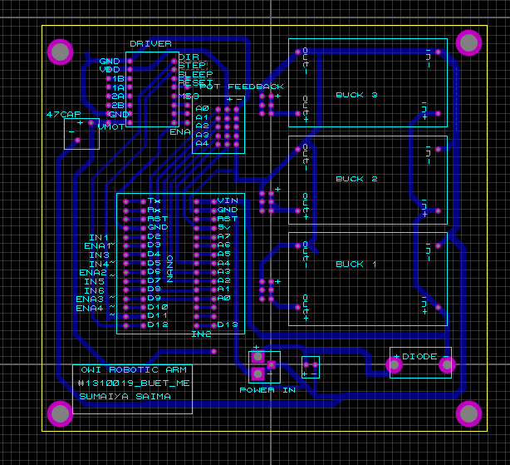
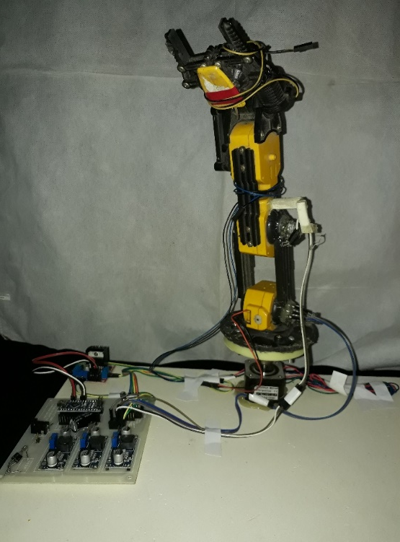
Undergrad thesis: Study on Performance of PI controller with structural modification including computer control of an OWI robotic arm
The performance of PI controller of a 5 DOF OWI-535 Robotic Arm Edge with some structural modifications has been demonstrated in this work. These modifications have paved the way for introducing feedback control system for the PMDC motors used in the arm. A control circuit has been designed for this study. The design has been implemented on a PCB. With proper tuning of controller gains K_{p} and K_{i}, standard behaviors of PI controller have been validated. A GUI has also been designed using python for providing computer control for the arm.
Figure: Modified OWI-535 arm with control circuit
Figure: Control circuit diagram used for the robotic arm , designed in Proteus
Figure: Effect of various values of K_{p} on the arms performance for a certain output angle

Slide 2
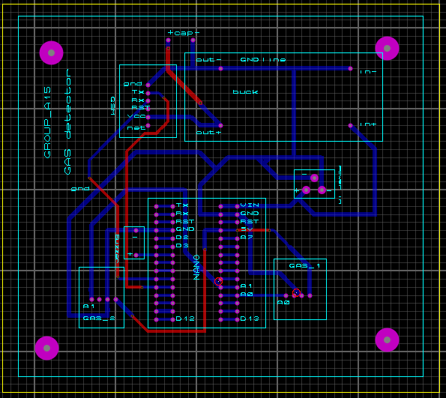
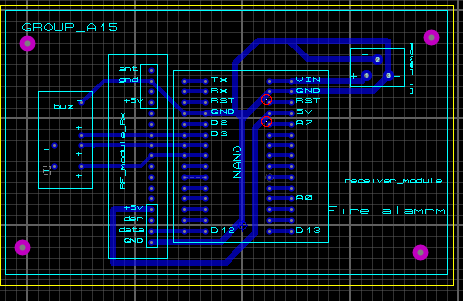
Course project: Gas Leakage Alarm system for Smart Home with Automatic Safety Measures
A gas leakage alarm system was designed to detect gas leakage in households using MQ-5 gas sensors. For the alarm system RF module, GSM module and buzzers were used. An automatic window opener for sliding windows was designed using belt pulley system. Circuits for the sensors and other module interfaces with Arduino were designed in Proteus are given below.
Figure: Control circuit diagram for the Gas detector system
Figure: Control circuit diagram for the alarm system

Slide 3
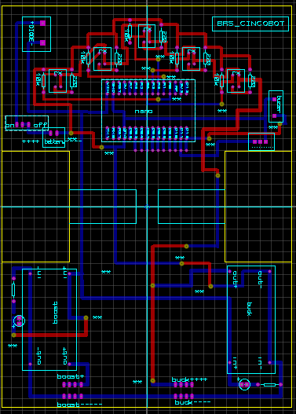
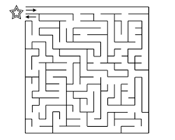
Competition project: Maze solver robot using microcontroller
A maze solver was designed using ‘left hand rule’ algorithm which traversed a maze first and then it could return to the starting point following the shortest path.
The body of the maze solver was itself a printed circuit board(PCB) as shown in the image.TCRT500 sensors were used for detecting lines of the maze. This particular placement of the sensors shown in the figure made the line detection faster and more efficient.
L298N driver was used for controlling motor with Arduino microcontroller. It included automatic calibration system for possible change in brightness in the environment.
Figure: Sample track for the maze solving problem; the robot is allowed to traversed the track once; and next it must complete the track following the shortest path
Figure: Circuit diagram for the robot, the PCB itself used as the body of the maze solver

Slide 4
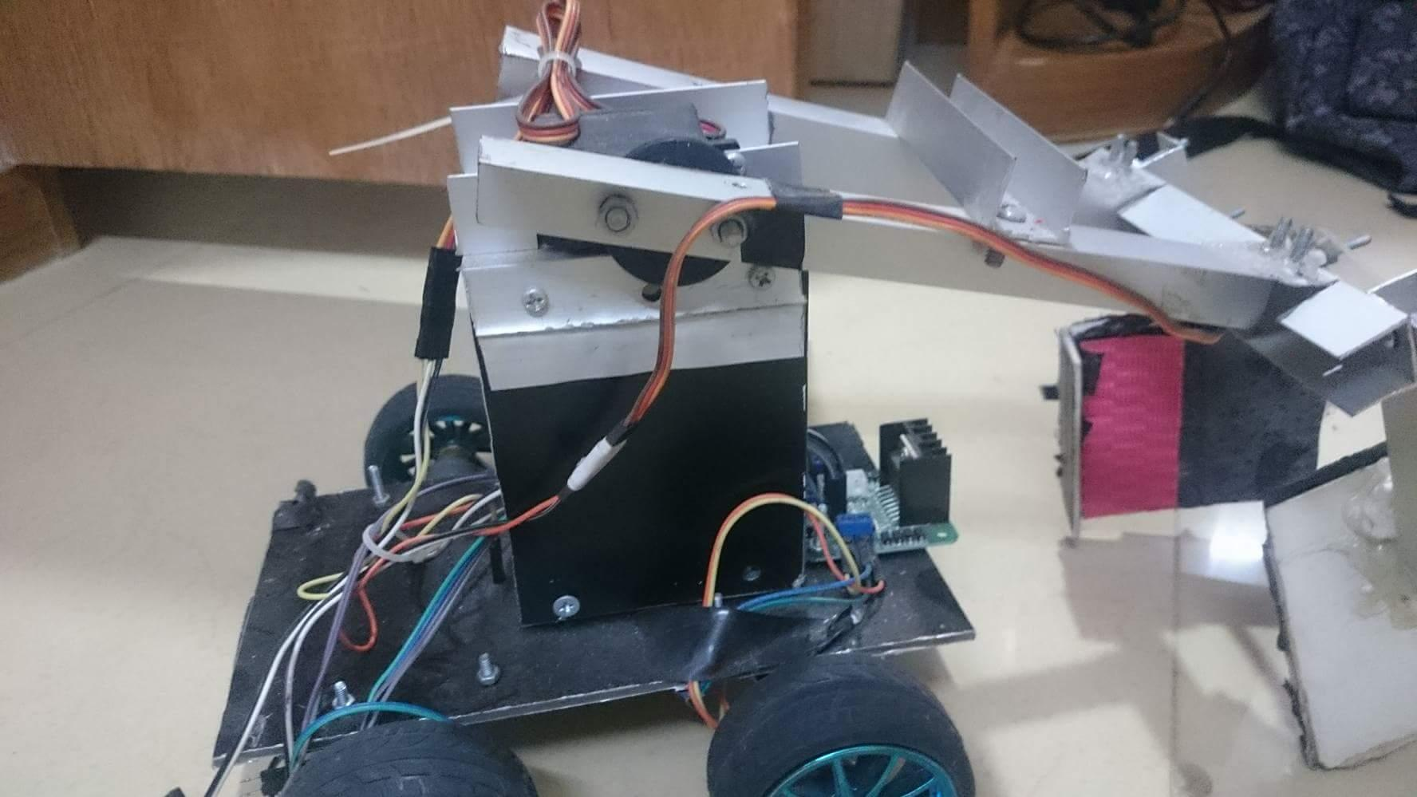
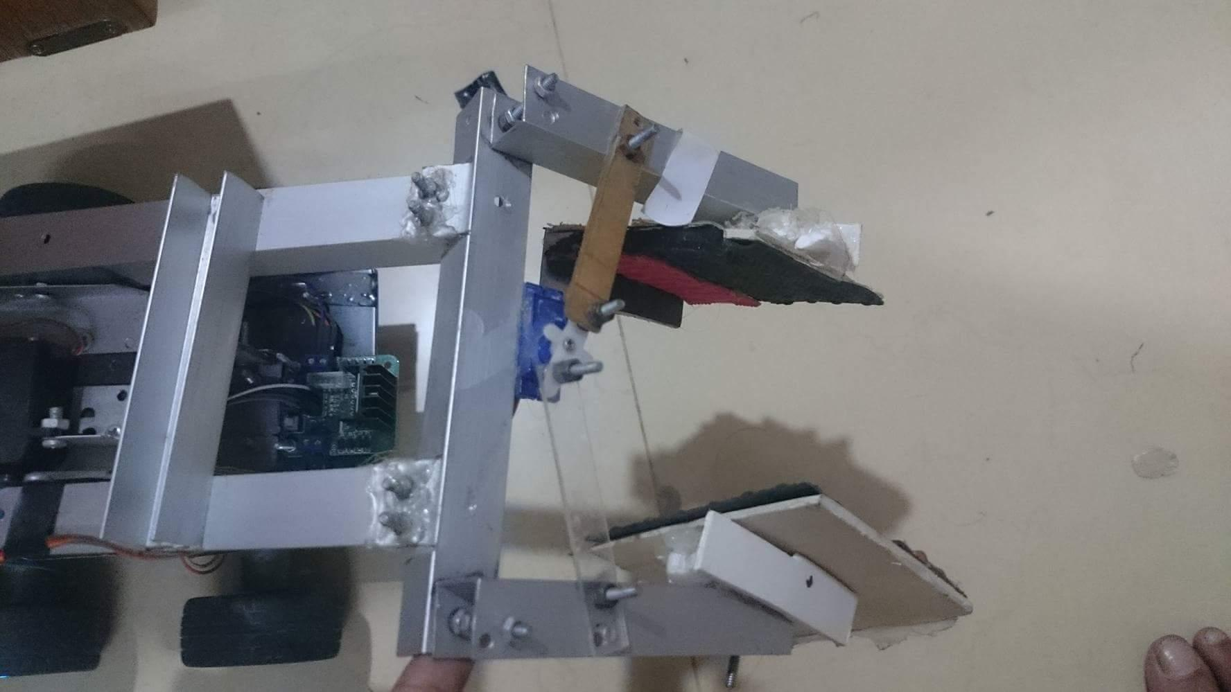
Hobby Project: Remote controlled vehicle with robotic arm for object pick & place
A 4 wheeled vehicle with a robotic arm was built which was wirelessly controlled using Arduino Mega ADK. The arm had 3 degrees of freedom having 3 servo motors. The DC motors used for wheels were controlled by L293N motor driver. The arm could be controlled using an android app to pick and place light objects.
Figure: Structure of the vehicle
Figure: Attached arm with the vehicle

